Slide 1
Nihongo Relay
Notes:
チームを確認する際、日本語で色を確認する

Slide 2
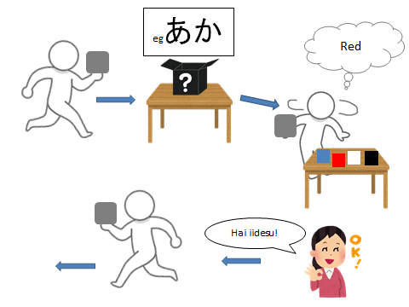
あそびかた
Walk to the table while balancing a paper balloon on your hand
Select a hiragana card from the box （eg あか）
Choose the matching colour card
4. Check with the teacher if
the colour is correct
5. If it is correct, pass the
balloon to the next
student in the relay

Slide 3
くろ
あお
しろ
あか

Slide 4
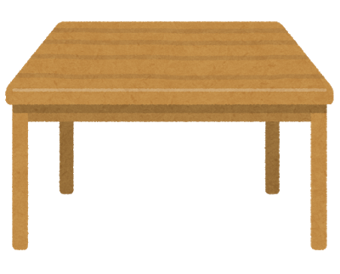
START
egあか
Red
Hai iidesu!

Slide 5
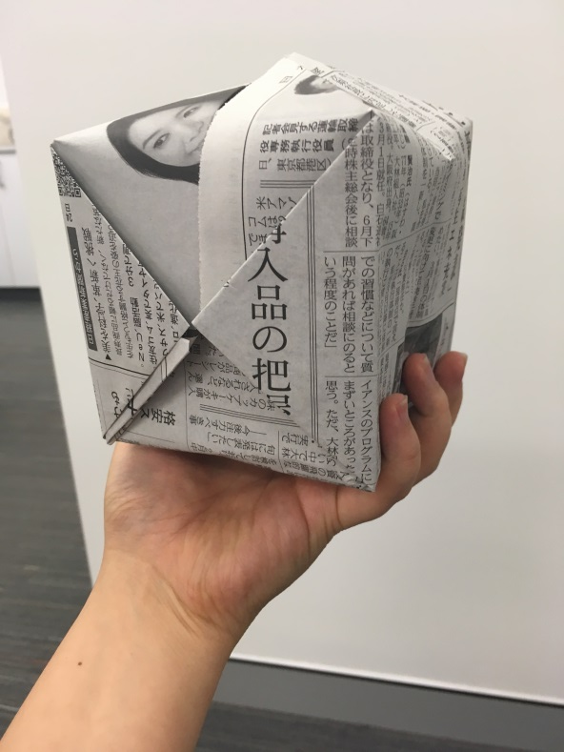
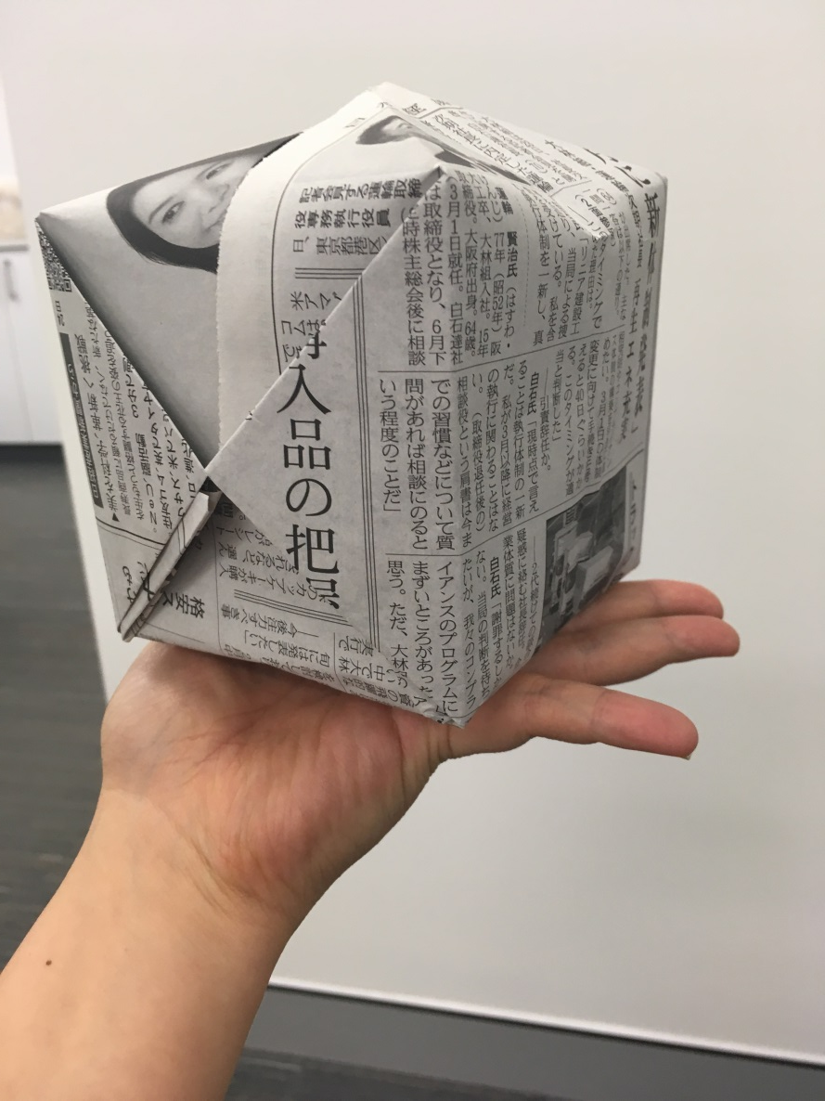
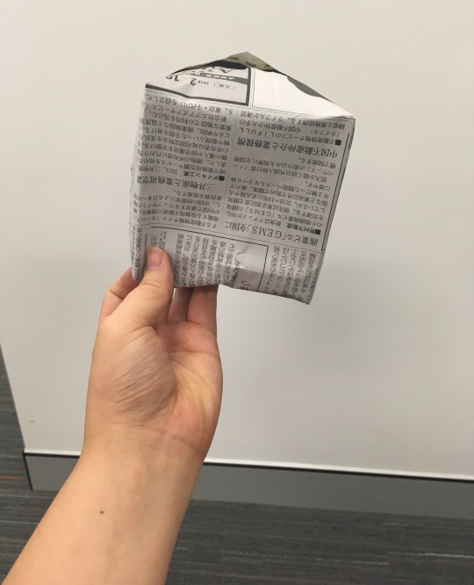
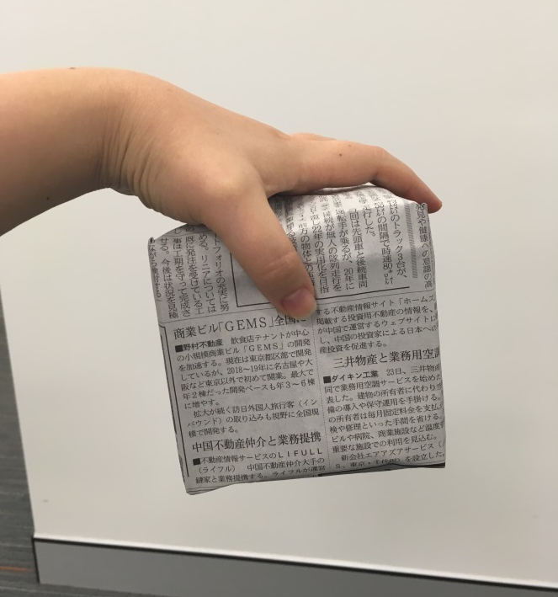
Place a balloon on your hand during the relay
Do not hold a balloon

