Slide 1
日本のたべもの Japanese Food
Round 1

Slide 2
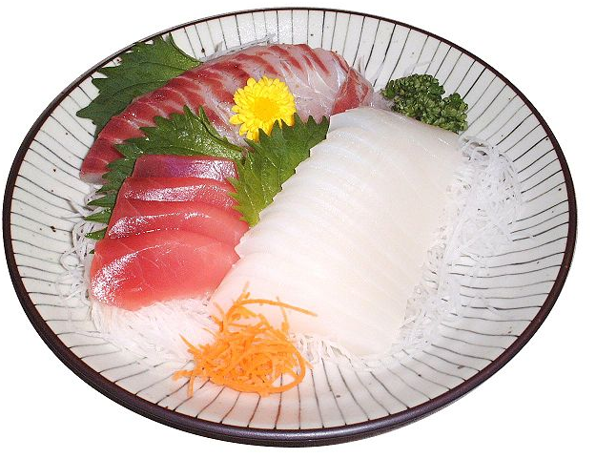
Q1. What is this dish called?

Slide 3
Q1. What is this dish called?
あ
い
SASHIMI
SUKIYAKI
さしみ
すきやき
う
え
SUSHI
TERIYAKI
すし
てりやき

Slide 4
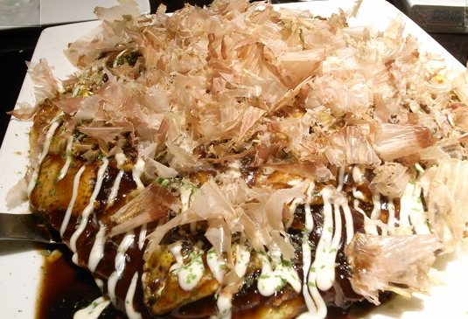
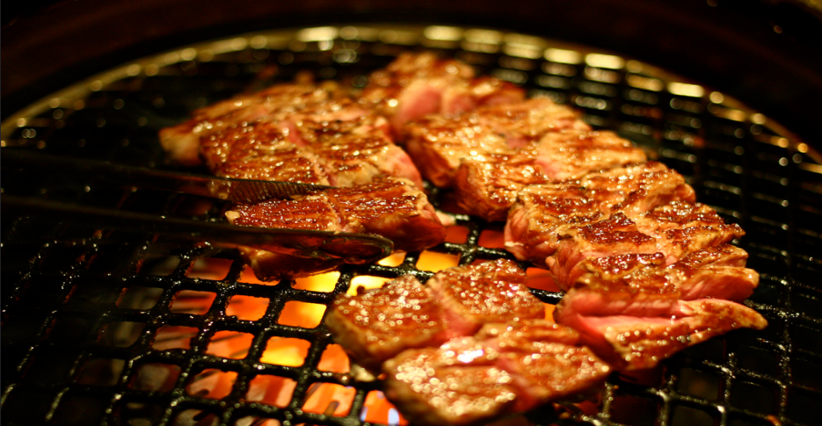
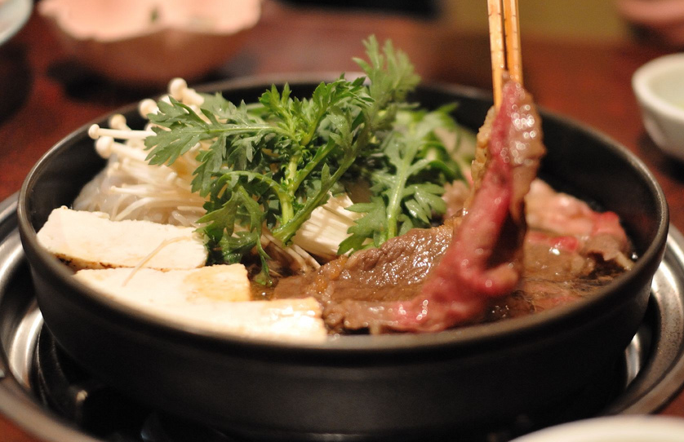
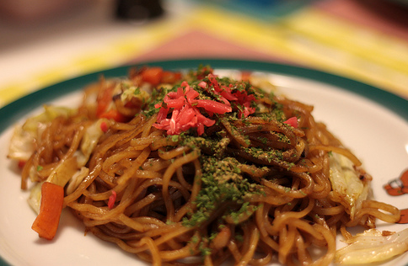
Q2. Which one of these dishes is sukiyaki?
あ
い
Okonomiyaki
Yakiniku
う
え
Sukiyaki
Yakisoba

Slide 5
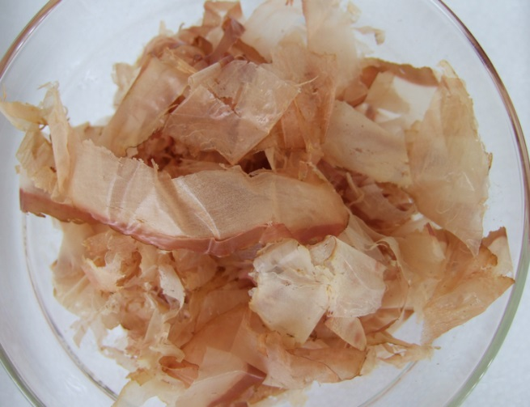
Q3. What is this okonomiyaki garnish made of?

Slide 6
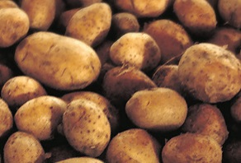
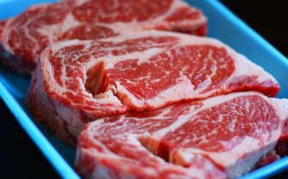
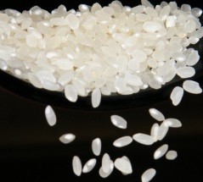
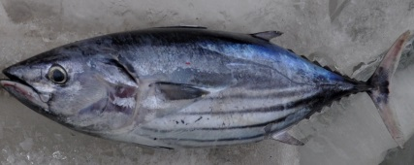
Q3. What is this okonomiyaki garnish made of?
あ
い
jagaimo
niku
じゃがいも
にく
う
え
kome
sakana
こめ
さかな

Slide 7
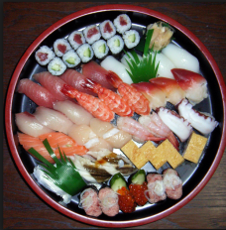
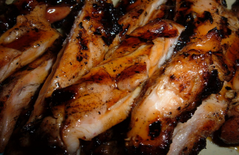
Q4. Which of these can you find at McDonalds in Japan?
あ
い
すしバーガー
SUSHI BURGER
TERIYAKI BURGER
てりやきバーガー
う
え
やきそばバーガー
すきやきバーガー
YAKISOBA BURGER
SUKIYAKI BURGER

Slide 8
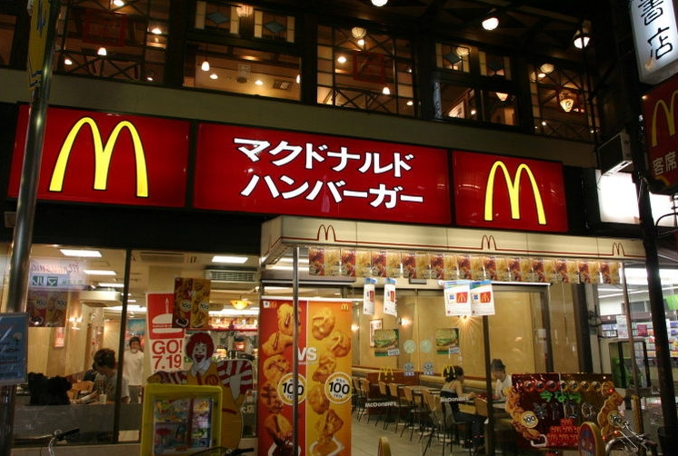
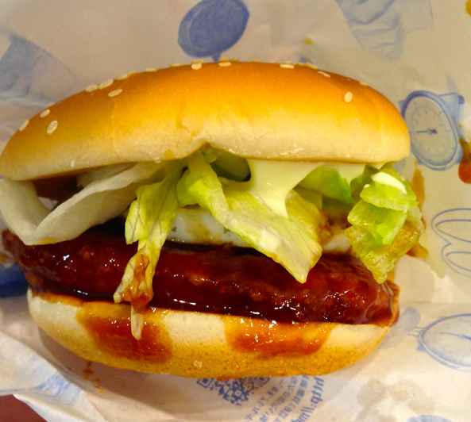
Q4. Which of these can you find at McDonalds in Japan?
てりやきバーガー

Slide 9
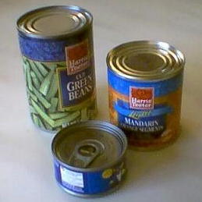
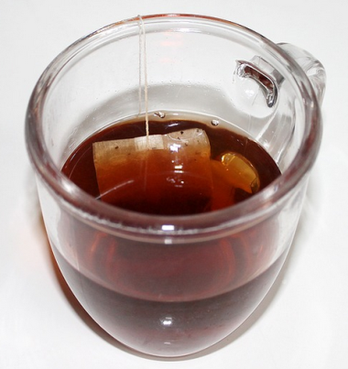
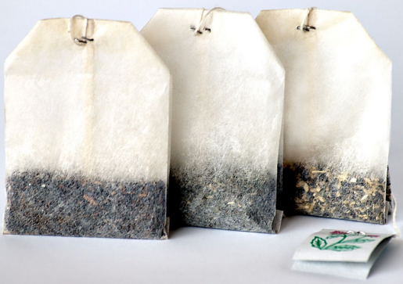
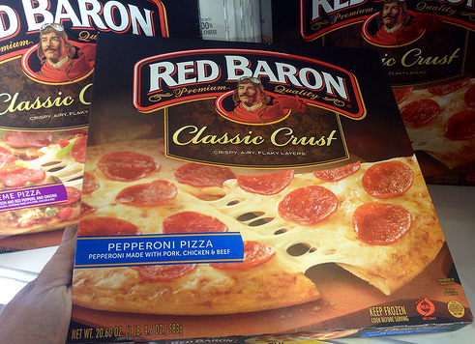
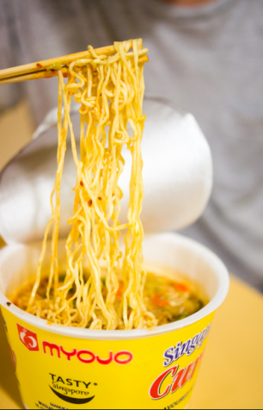
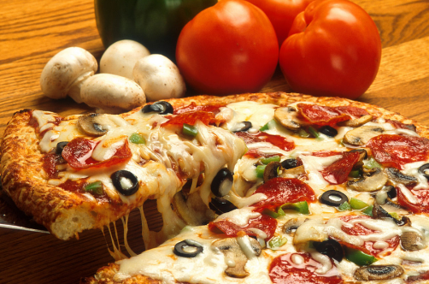
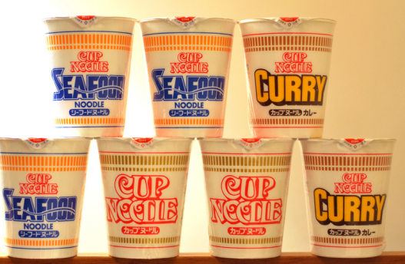
Q5. Which of these foods or drinks originated in Japan?
あ
い
う
え

Slide 10
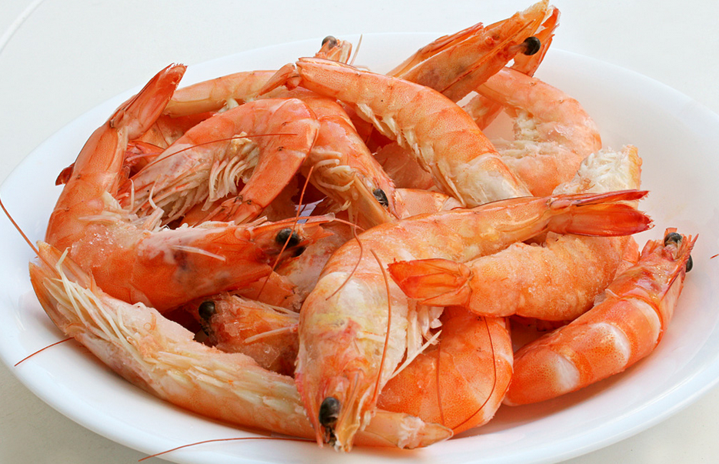
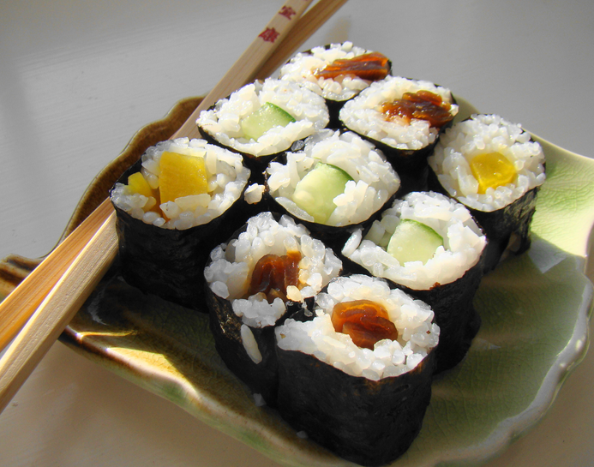
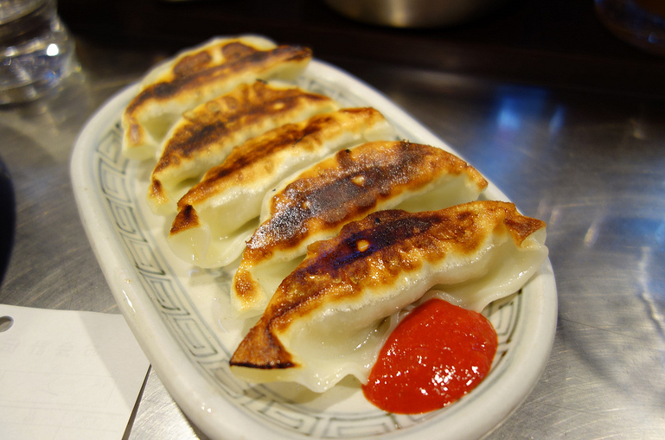
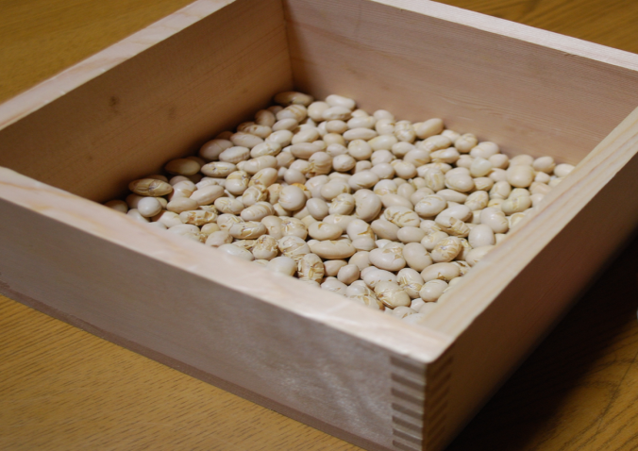
Q6. On February 3 (Setsubun) Japanese people eat one of these for each year of their life. Which food?
あ
い
まきずしMakizushi
えび Ebi
う
え
ふくまめ Fukumame
ぎょうざ Gyouza

Slide 11
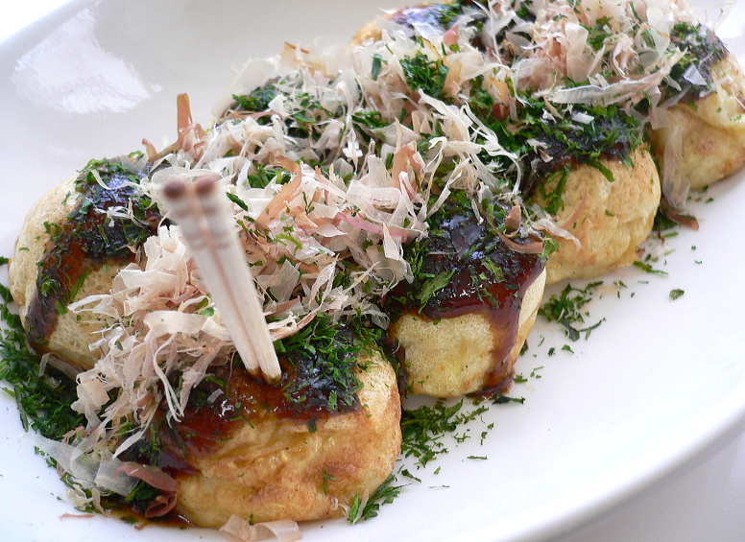
Q7. What’s inside?

Slide 12
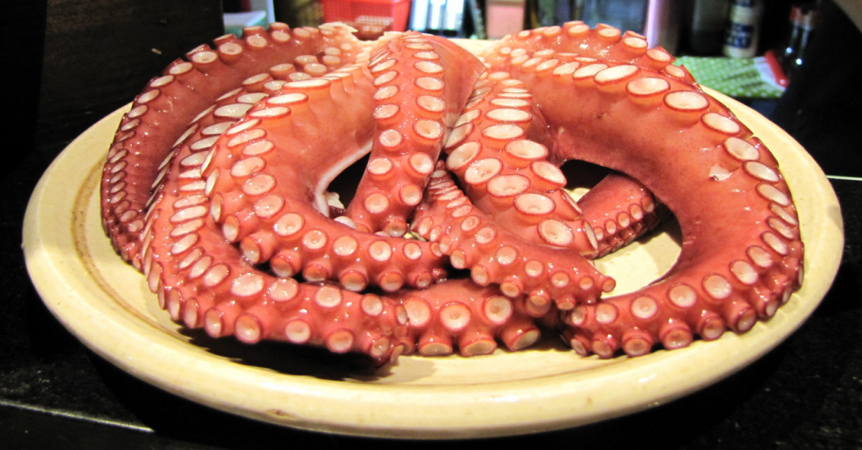
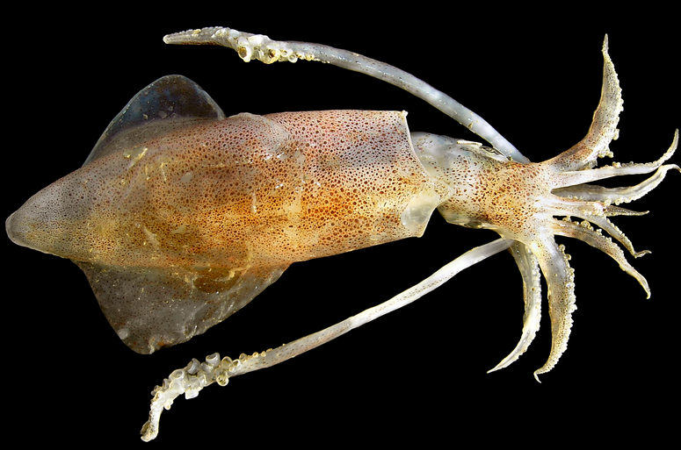
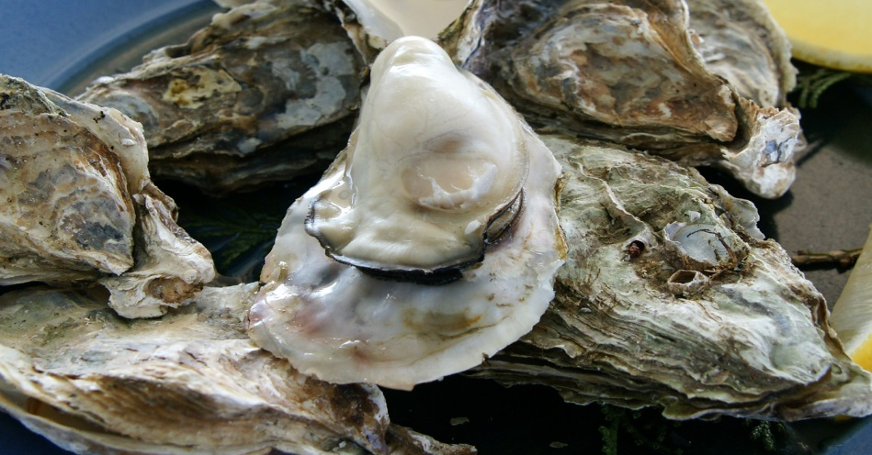
Q7. What’s inside?
あ
い
たこ Tako
いか Ika
う
え
えび Ebi
かき Kaki

Slide 13
たこやき Takoyaki

Slide 14
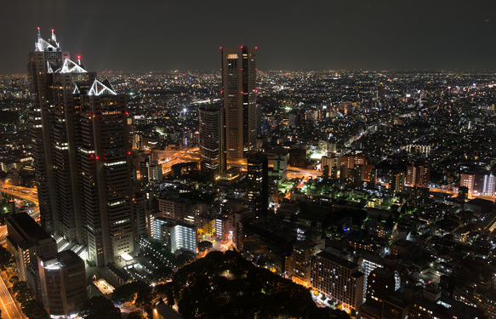
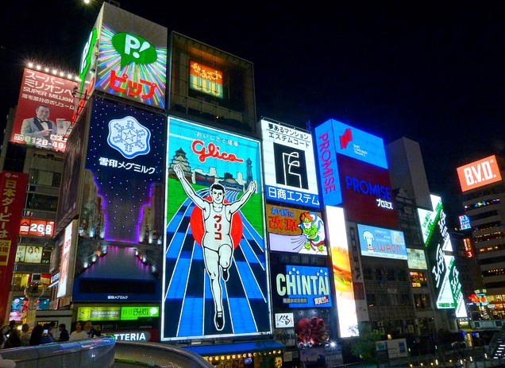
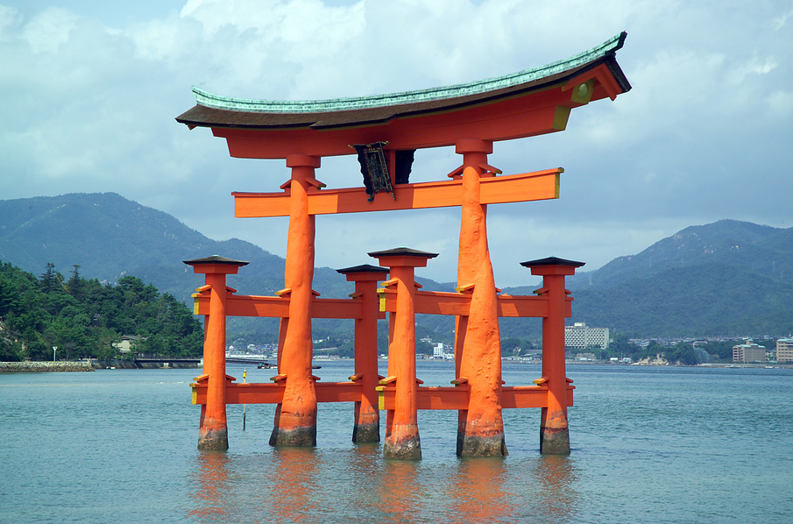
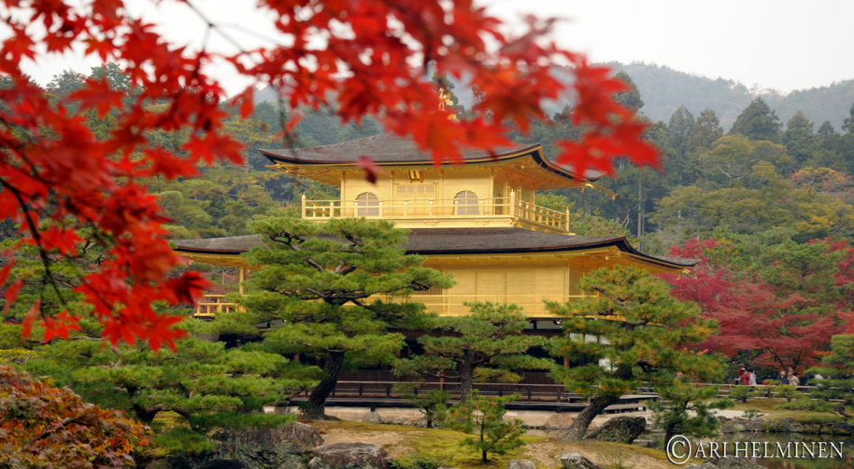
Q8. Where is takoyaki famous?
あ
い
とうきょう
Tokyo
おおさか Osaka
う
え
ひろしま Hiroshima
きょうと Kyoto

Slide 15
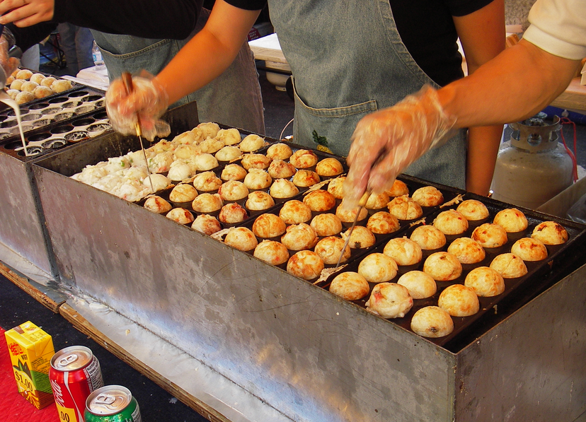
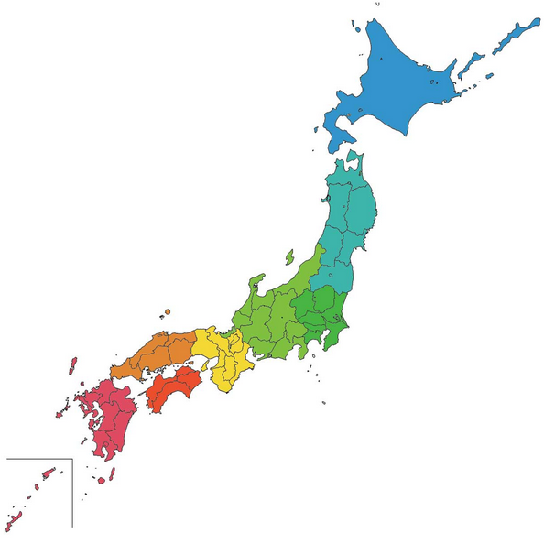
Q8. Where is takoyaki famous?
大阪名物
Osaka specialty

