Slide 1
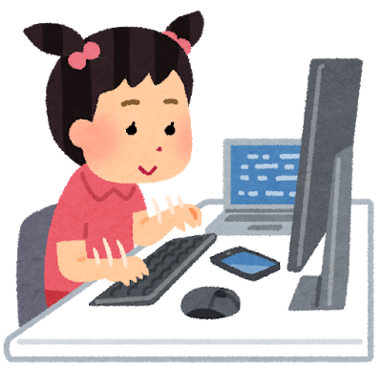
Lesson idea 1 : Role play
© The Japan Foundation, Sydney

Slide 2
Lesson plan
Aim | Offering food to a Japanese friend
1 | Vocabulary games 5min
2 | Conversation practice 5min
3 | Role play (recording) 7min
4 | Send a sound file to せんせい 3min

Slide 3
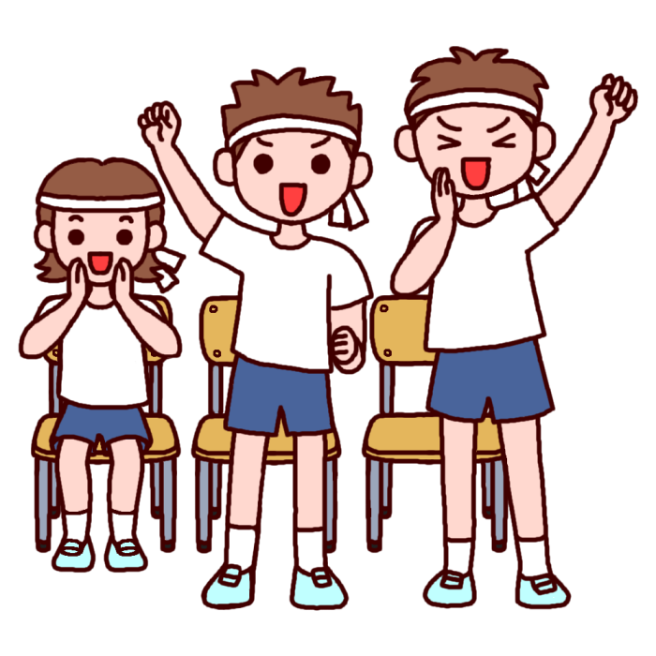
Ganbatte!
Notes:
(Most of activity is the team match, so please encourage your teammates!)
This is a team competition, so please cheer for your teammates!

Slide 4
Vocabulary games
Memory game: Read the following words together and remember what they mean.
いっしょによんで おぼえましょう

Slide 5
ばなな banana

Slide 6
れもん remon

Slide 7
まんごー mangoo

Slide 8
おれんじ orenji

Slide 9
きうい kiui

Slide 10
ちぇりー(さくらんぼ） cherii

Slide 11
らずべりー razuberii

Slide 12
りんご ringo

Slide 13
もも momo

Slide 14
かいてください。
Write down all the words you remember in your exercise book. If you want to challenge yourself, write them in Hiragana.
Let’s check the answer with せんせい

Slide 15
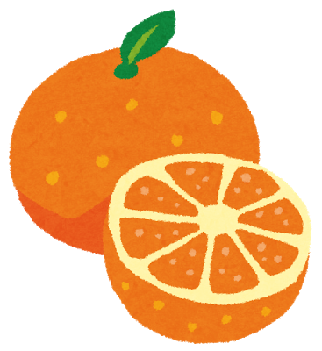

Slide 16
Conversation practice
Practice how to offer food to a Japanese person.
Let’s read a model conversation together
では、いっしょによみましょう

Slide 17
Model conversation
りんごがすきですか？
はい、すきです。
ももがすきですか？
ももは、あんまり…..
じゃ りんごをどうぞ
いただきます!、

Slide 18
Role play
Create a conversation using the following speech bubbles with your partner and record the conversation.
では、ペアでかいわをつくって
ろくおんしてください。

Slide 19
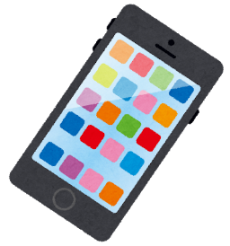
Instructions:
1. Students go into breakout rooms on ZOOM or MS teams.
Remove headphones from their computers and record the conversation on their phones using the voice memo.
3. Send the sound file to the teacher.
はい、
すきです。
りんごは
すきですか。

Slide 20
Create a conversation with a partner and record the conversation.
がすきですか？
はい、すきです。
がすきですか？
は、あんまり…..
じゃ をどうぞ
いただきます !

Slide 21
When you finish recording,
send the conversation to せんせい.
おわりましたら、かいわを
せんせいに おくってください。

