Slide 1
Brain Break in Japanese: Enjoy Animal Yoga Poses!
©The Japan Foundation, Sydney

Slide 2
Schedule
Vocabulary Check
Matching Game
Try yoga with Sensei!
Let’s become a yoga teacher!

Slide 3
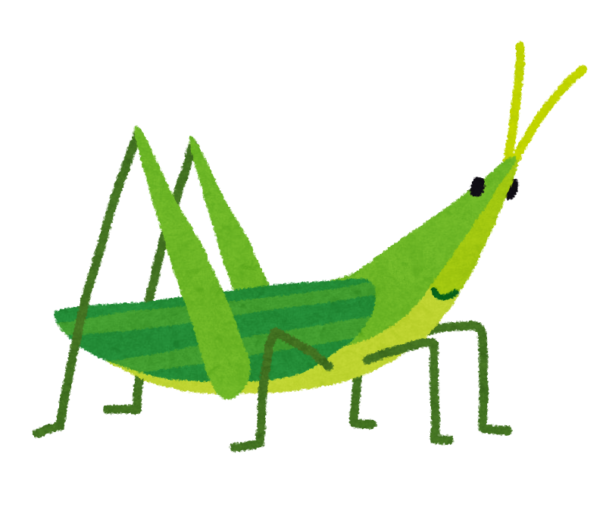
Read aloud each word after Sensei!
ばった
batta

Slide 4
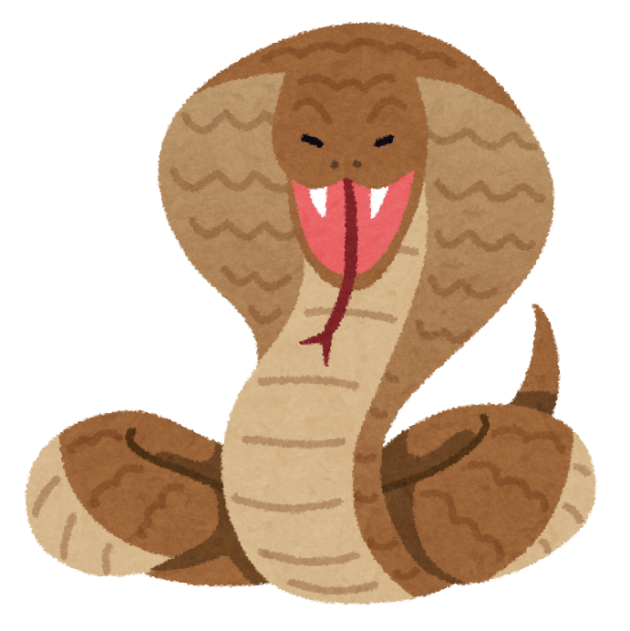
Read aloud each word after Sensei!
へび
hebi

Slide 5
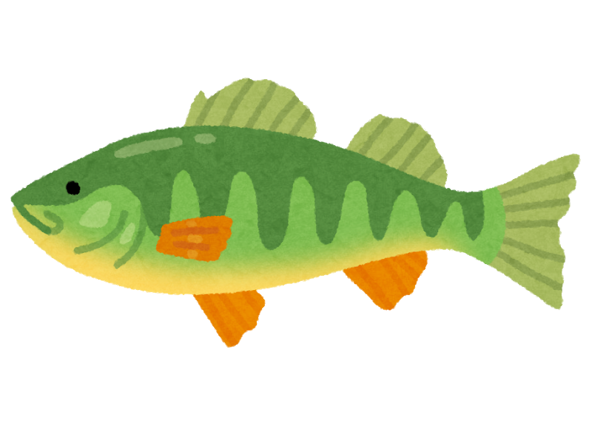
Read aloud each word after Sensei!
さかな
sakana

Slide 6
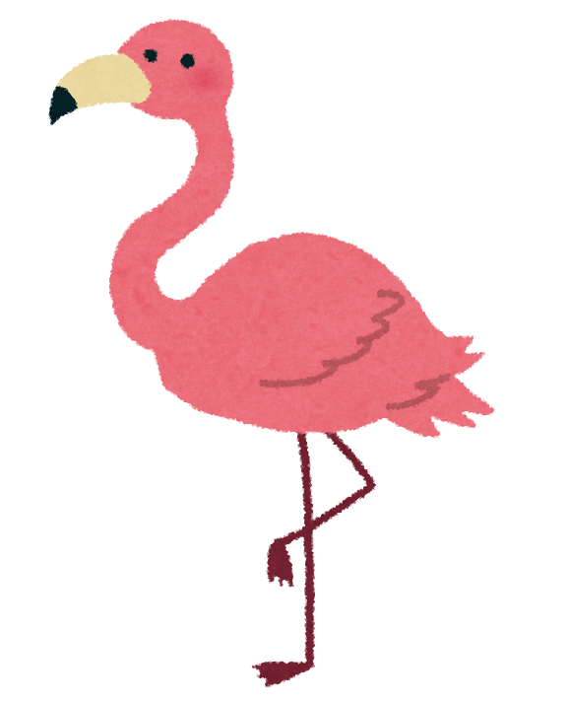
Read aloud each word after Sensei!
ふらみんご
furamingo

Slide 7
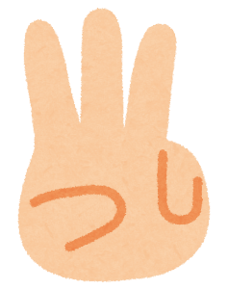
Quiz 1: Listen to Sensei, show your finger # for the right answer.
1
2
3
4

Slide 8
Quiz 2: これは、なんですか？ What is this? kore wa nandesu ka
①ばった ②へび ③ふらみんご ④さかな
batta hebi furamingo sakana

Slide 9
Quiz 2: これは、なんですか？ What is this? kore wa nandesu ka
①ばった ②へび ③ふらみんご ④さかな
batta hebi furamingo sakana

Slide 10
Quiz 2: これは、なんですか？ What is this? kore wa nandesu ka
①ばった ②へび ③ふらみんご ④さかな
batta hebi furamingo sakana

Slide 11
Quiz 2: これは、なんですか？ What is this? Kore wa nandesu ka
①ばった ②へび ③ふらみんご ④さかな
batta hebi furamingo sakana

Slide 12
Check with a partner: show your finger # to a partner, the partner says the word.
1
2
3
4

Slide 13
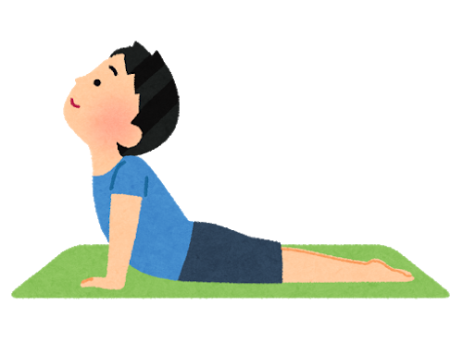
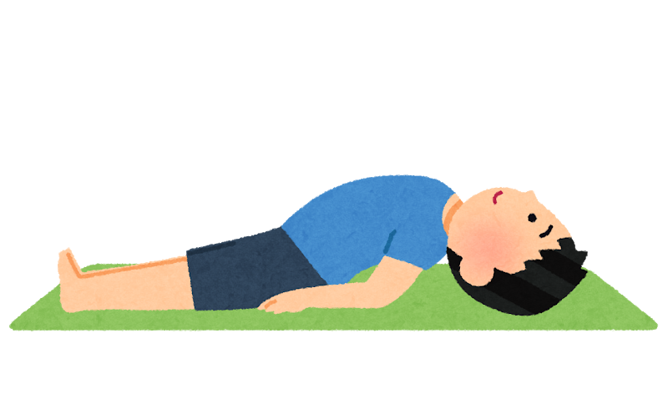
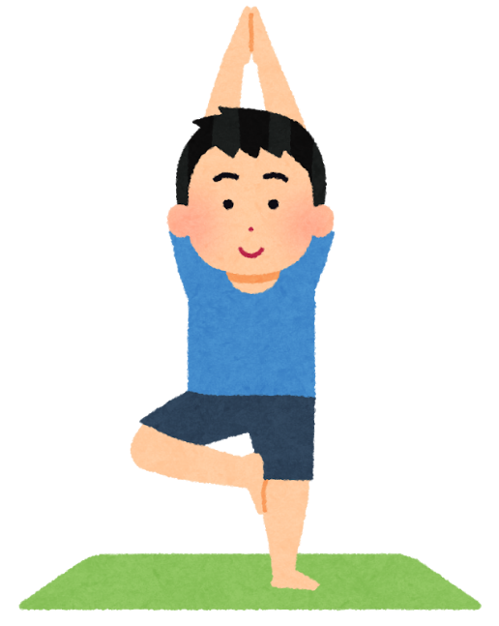
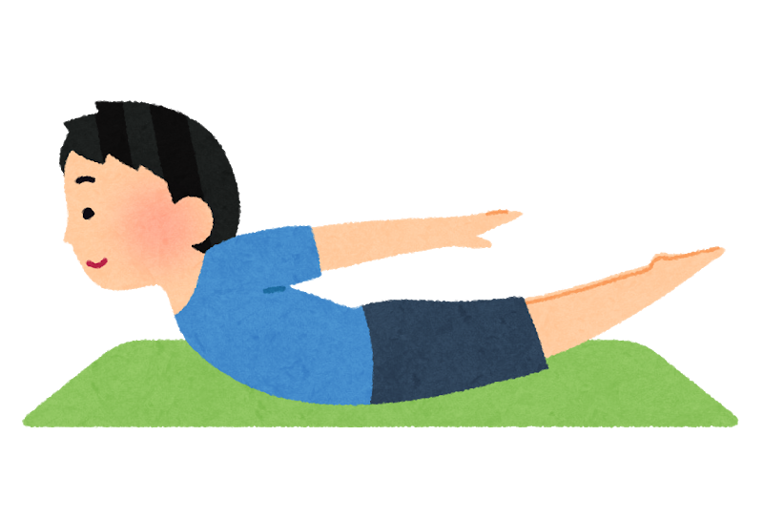
Animal yoga poses

Slide 14
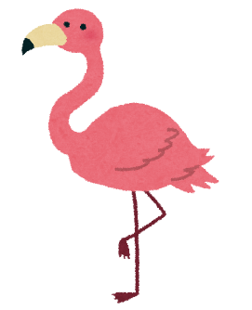
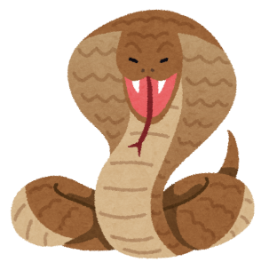
Match each yoga pose with the right animal. Show your finger # to the camera.
1
2
3
4

Slide 15
Match each yoga pose with the right animal. Show your finger # to the camera.
1
2
3
4

Slide 16
Match each yoga pose with the right animal. Show your finger # to the camera.
1
2
3
4

Slide 17
Match each yoga pose with the right animal. Show your finger # to the camera.
1
2
3
4

Slide 18
Try yoga with Sensei! Yoga mat/towel はありますか？

Slide 19
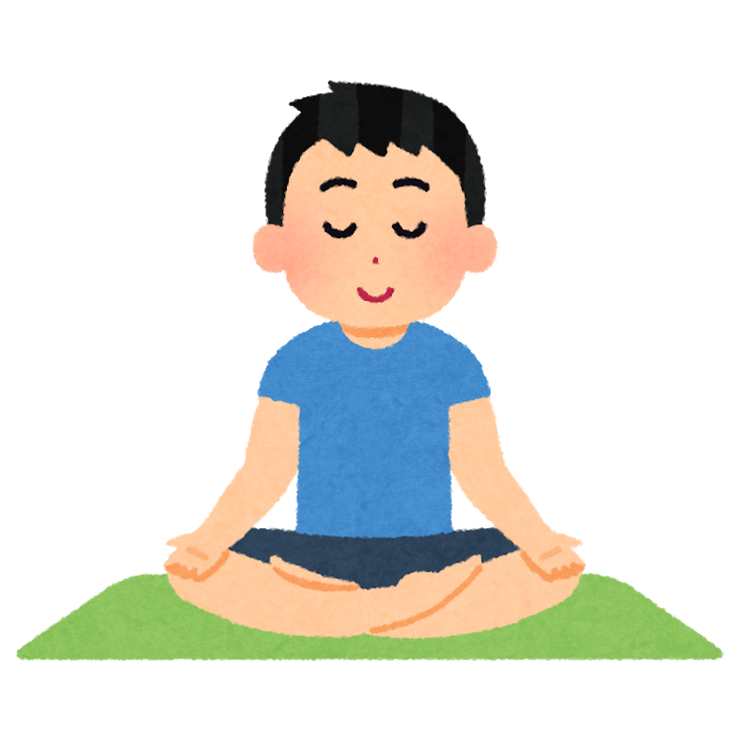
Meditation
①はなから いきを すって
hanakara ikio suttee
Breathe in from the nose
②はいて
haite
Breathe out (from the nose)

Slide 20
へび hebi
①うつぶせに ねて
Utsubuseni nete
Lay on your front facing down
②からだ そらして
Karada sorashite
Raise your back

Slide 21
ばった batta
①うつぶせに ねて
utsubuseni nete
Lay on your front facing down
②あたまと あしを あげて
atamato ashio agete
Lift your head and legs up

Slide 22
さかな sakana
①あおむけに ねて
aomukeni nete
Lay down facing up
②てを おしりの したに
teo oshiri no shita ni
Put hands under your hip
③むねをあげて
mune o agete
Raise your chest

Slide 23
ふらみんご furamingo
①てを うえに
teo ueni
Hands up
②かたあし あげて
kataashi agete
Raise one leg
③まっすぐ たって
massugu tatte
Stand straight

Slide 24
Let’s become a yoga teacher!
Teacher’s Notes:
1) Make groups of three, and let one student teach 4 poses to the other group members.
Tips: If you are streaming the PPT, ask students to take screenshots of the slides as you go. Otherwise, they might not remember what to say. Alternatively, you could share the slides with them on google slides.
2) As an assignment, students practice yoga with their family or pets. (Option: record a video on a phone and send it to the teacher.)

Slide 25
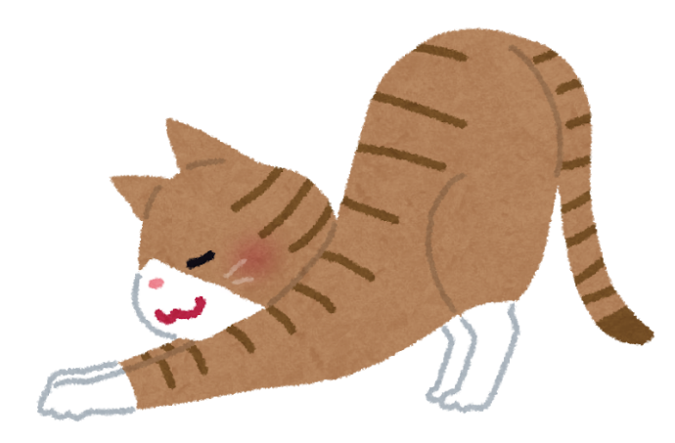
USEFUL WEBSITE
If you are not able to show yoga poses to your students yourself, there is a yoga video for children. Whenever you think your students need a break, you can show them the video and do it together. OR you can even assign students the task to teach yoga in Japanese to their family or pets.
ピンキッツ(PINKFONG):https://www.youtube.com/watch?v=twbQ_Ea0SHI
Animal yoga for kids with a song:
⇒3 poses: ねこ(Cat), ふらみんご(Flamingo), へび(Snake)
⇒Key words: すてきsuteki, かわいいkawaii
©The Japan Foundation, Sydney

